Slide 1

American International University-Bangladesh
Serial Communications Interfaces
BY TAHMIDA ISLAM

Slide 2
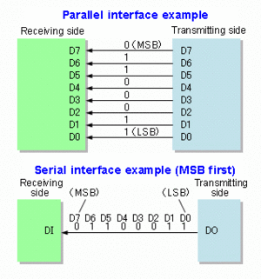
Data Transmission
Data transmission can be performed two ways.
Parallel Communications, where several bits of data are transmitted/received as a whole, on a link with several parallel channels.
Serial Communications, where data is transmitted/received bit by bit through a single channel.

Slide 3
Serial Data Communication
Advantage of serial communication: Smaller number of communication lines is required compared to parallel communication.
2 lines (transmit & receive) are required in asynchronous full duplex serial comm.
3 lines (transmit, receive & clock) are required in synchronous serial communication.
Disadvantage of serial communication: More time is required to transmit/receive compared to parallel communication.

Slide 4
Types of Serial Communication
ATmega328 has 3 types of serial communication interfaces:
1. Universal Synchronous Asynchronous Receiver & Transmitter (USART).
2. Serial Peripheral Interface (SPI).
3. Two Wire Interface (TWI)/ Inter-Integrated Circuit (I2C).

Slide 5
USART vs UART
 | UART | USART
Full Name | Universal Asynchronous Receiver/Transmitter | Universal Synchronous/Asynchronous Receiver/Transmitter
Data type and rate | It generates asynchronous data, hence has low data rate. | It generates clocked/synchronous data, hence has higher data rate.
Baud rate | Receiver need to know baud rate of the transmitter before communication to be established so that UART can generate clock internally and synchronize it with data stream with the help of transition of start bit. | Receiver need not be required to know the baud rate of the transmitter. This is derived from the clock signal and data line.
Data Structure | It uses start bit (before data word), stop bits (one or two, after data word), parity bit (even or odd) in its base format for data formatting. | USART can also generate data similar to UART. Hence USART can be used as UART but reverse is not possible.
Protocol | UART is simple protocol to generate data. | USART is complex and uses many different protocols to generate the data for transmissions.

Slide 6
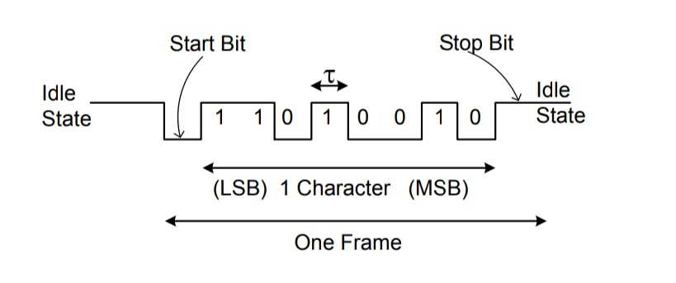
USART
It is an asynchronous serial communication.
It uses 2 pins in Port D:
1. TXD/PD1 – The serial data transmission line.
2. RXD/PD0 – The serial data reception line.
Data is transmit/receive in a serial frame as follow:

Slide 7
USART
Each bit is sent with a specific time duration τ, called bit-time. The smaller is τ, the faster is data transmission. The rate of data transmission /reception is called the Baud rate. Standard Baud rate: 2400, 4800, 9600, 14400,19200,. .
In the ATmega328, the Baud rate is generated from internal clock. The Baud rates at the transmitter & receptor must be the same to avoid communication error. The baud error should be < ± 2% to avoid communication error.
Baud error= ((standard baud rate- calculated baud rate)/standard baud rate)x 100 %

Slide 8
USART : Internal Clock Generation – The Baud Rate Generator
Internal clock generation is used for the asynchronous and the synchronous master modes of operation.
The USART Baud Rate Register (UBRRn) and the down-counter connected to it functions as a baud rate generator.
The down-counter, running at system oscillator clock frequency (fosc), is loaded with the UBRRn value each time the counter has counted down to zero thus a clock is generated.
The Transmitter divides the baud rate generator clock output by 2, 8 or 16 depending on mode.
The baud rate generator output is used directly by the Receiver’s clock and data recovery units.

Slide 9
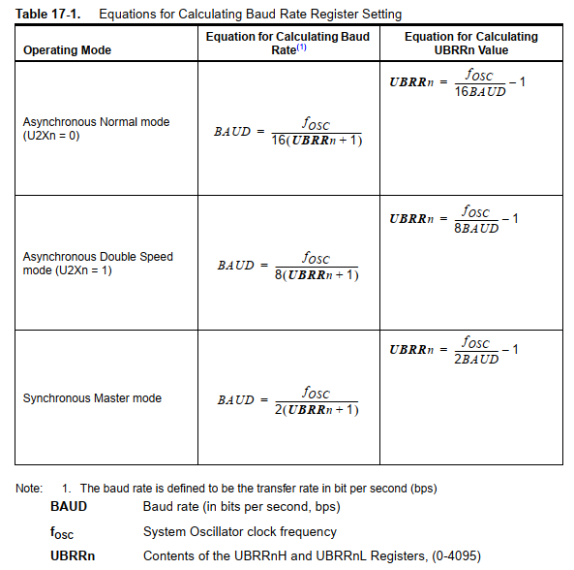

Slide 10
Example to practice: Find the baud rate for the three operating modes when fOSC = 1MHz and UBRRn = 25. Calculate the baud error and comment whether there will be any communication error or not.
Solution:
For asynchronous normal mode:
BAUD rate = fOSC /( 16 (UBRRn+1))
= (1x10^6)/ (16(25+1))
= 2403 bits per second
Baud error= ((2400-2403)/2400)x 100%
= -0.125% < ± 2%
So there will be no communication error for the given information.

Slide 11
Continuation: .
For synchronous master mode:
BAUD rate = fOSC /( 2(UBRRn+1))
= (1x10^6)/ (2(25+1))
= 19230 bits per second
Baud error= ((19200-19230)/19200)x 100%
= -0.16% < ± 2%
So there will be no communication error for the given information.
For asynchronous double speed mode:
BAUD rate = fOSC /( 8(UBRRn+1))
= (1x10^6)/ (8(25+1))
= 4807 bits per second
Baud error= ((4800-4807)/4800)x 100%
= -0.15% < ± 2%
So there will be no communication error for the given information.

Slide 12
USART- Arduino Libraries
USART functions can be used with Serial Monitor of Arduino.
1. Serial.begin(baud) – to enable input/output to serial monitor with baud speed. Must be written in setup()
2. Serial.available() – Get the number of bytes (characters) available for reading from the serial port.
3. Serial.println(val) – to display val value to serial monitor with newline added.
4. Serial.print(val) – as above but without newline.
5. Serial.print(“Error”) – display message “Error” without newline.
6. Serial.read() – Reads incoming serial data.
others functions – refer to arduino.cc.

Slide 13
Advantage of USART
Hardware complexity is low.
As this is one to one connection between two devices, software addressing is not required.
Due to its simplicity, it is widely used in the devices having 9 pin connector.
Disadvantage of USART
It is suitable for communication between only two devices.
It supports fixed data rate between devices wanting to communicate otherwise data will be garbled(distorted ,unclear).

Slide 14
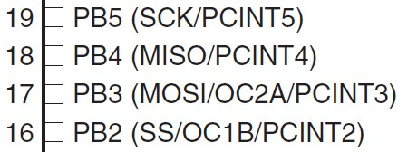
Serial Peripheral Interfaces (SPI)
SPI is a synchronous data communication.
SPI uses 4 pins in Port B:
MISO/PB4 – Master In Slave Out, the Slave line for sending data to the master.
MOSI/PB3 – Master Out Slave In, the Master line for sending data to the peripherals (Slave).
SCK/PB5 – The clock pulses which synchronize data transmission generated by the master.
SS/PB2 – The pin on each peripheral that the master can use to enable & disable it.

Slide 15
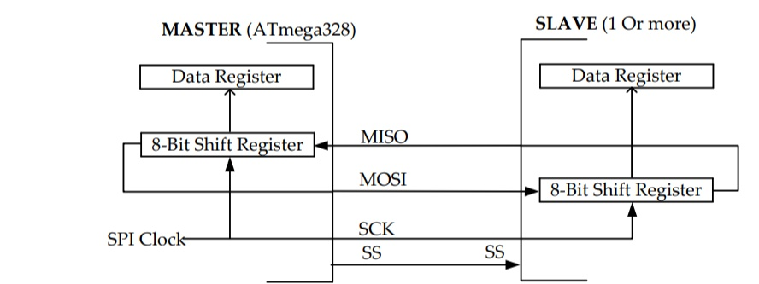
Serial Peripheral Interfaces (SPI)
Connection using SPI is in the Master-Slave configuration.
Master – Normally, is the ATmega328. Master initiate the data transfer. SPI clock is also generated by master.
Slave – Consist of 1 or more SPI I/O peripherals. The slave transfer data as a reaction to master.

Slide 16
SPI Arduino Libraries
SPI.begin() – Initializes the SPI bus by setting SCK, MOSI, and SS to outputs, set SCK & MOSI low, & SS high. Must be written in setup()
SPI.end() – Disables the SPI bus.
SPI.setBitOrder(order) – Sets the order of the bits shifted out of & into the SPI bus, either LSBFIRST or MSBFIRST.
SPI.setClockDivider(divider) – Sets the SPI clock divider. The default setting is SPI_CLOCK_DIV4, which sets the SPI clock to 4 MHz for Uno
SPI.setDataMode(mode) – Sets the SPI data mode: clock polarity & phase. Available modes: SPI_MODE0 – SPI_MODE3. refer to arduino.cc
SPI.transfer(val) – Transfers one byte over the SPI bus, both sending & receiving. val: the byte to send out.
Returns: the byte read from the bus.

Slide 17
Advantages of SPI
It is simple protocol and hence so not require processing overheads.
Supports full duplex communication.
Due to separate use of CS lines, same kind of multiple chips can be used in the circuit design.
SPI uses push-pull and hence higher data rates and longer ranges are possible.
SPI uses less power compare to I2C

Slide 18
Disadvantages of SPI
As number of slave increases, number of CS lines increases, this results in hardware complexity as number of pins required will increase.
To add a device in SPI requires one to add extra CS line and changes in software for particular device addressing is concerned.
Master and slave relationship can not be changed as usually done in I2C interface.
No flow control available in SPI.

Slide 19
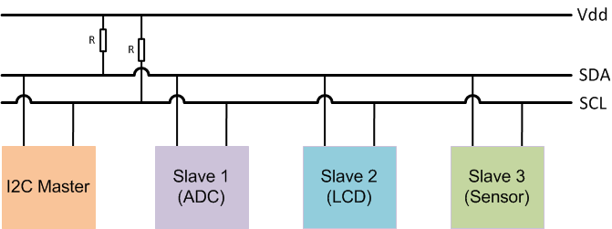
I2C(Inter-Integrated Circuit) A chip-to-chip protocol for communicating with low-speed peripherals

Slide 20
I2C (Inter-Integrated Circuit)
I2C (Inter-Integrated Circuit) is a serial protocol for two-wire interface to connect to low-speed devices like Micro-controller, EEPROMs, I/O Interfaces and other similar devices in Embedded Systems. Also, It can be said that I2C is a bus for communication between a master (or can be multiple masters) and a single or multiple slave devices.
I2C uses only two wires SCL (Serial Clock) and SDA (Serial Data).
SCL: The clock line used to synchronize all data transfers over the I2C bus.
SDA: The Data Line used for transmitting the Data between devices.

Slide 21
I2C Addresses
Each I2C Slave devices have a 7-bit addressing or also can have a 10-bit addressing. Addresses need to be unique on the Bus to determine the slave that where to transmit the data. The master device needs no address since it generates the clock (using SCL) and addresses individual I2C Slave devices.
The maximum number of Slave devices that can be used while using 7-bit addressing are 112 devices and the Maximum number of Slave devices used in 10-bit addressing are 1008 devices.

Slide 22
Working of I2C in Arduino
In I2C data transfer occurs in Message Frames which are then divided into Frames of Data. A message contains the various number of Frames in which one frame contain the address of the slave, and remaining frames for data to be transmitted.
The message includes START/STOP Conditions, READ/WRITE Bits and ACK/NACK (Acknowledgement/No-acknowledgement) Bits between each data Frame. Working shown below,
Start Condition: The SDA line switches from high to low voltage level before SCL switches from high to low.
Stop Condition: The SDA line switches from low to high voltage level after SCL switches from low to high.
Address Frame: 7 or 10-bit sequence unique to each slave that identifies the slave when the master wants to talk.
Read/Write Bit: A bit specifying whether the master is sending data to the slave or requesting data from it.
ACK/NACK Bit: Each frame in a message follows an ack/nack bit.

Slide 23
i2c_scanner
Find addresses of different i2c devices connected to Arduino
https://playground.arduino.cc/Main/I2cScanner/

Slide 24
#include <Wire.h>
void setup()
{
Wire.begin();
Serial.begin(9600);
while (!Serial); // Leonardo: wait for serial monitor
Serial.println("\nI2C Scanner");
}
void loop()
{
byte error, address;
int nDevices;
Serial.println("Scanning...");
nDevices = 0;
for(address = 1; address < 127; address++ )
{
// The i2c_scanner uses the return value of
// the Write.endTransmission to see if
// a device did acknowledge to the address.
Wire.beginTransmission(address);
error = Wire.endTransmission();
if (error == 0)
{
Serial.print("I2C device found at address 0x");
if (address<16)
Serial.print("0");
Serial.print(address,HEX);
Serial.println(" !");
nDevices++;
}
else if (error==4)
{
Serial.print("Unknown error at address 0x");
if (address<16)
Serial.print("0");
Serial.println(address,HEX);
}
}
if (nDevices == 0)
Serial.println("No I2C devices found\n");
else
Serial.println("done\n");
delay(5000); // wait 5 seconds for next scan
}

Slide 25
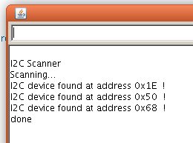
Upload it to the Arduino and open the serial monitor. Every found device on the I2C-bus is reported.
You can change the wires, and plug-in I2C devices while the i2c_scanner is running.
The output of the serial monitor will look like this:

Slide 26
Advantages of I2C
Due to open collector design, limited slew rates can be achieved.
More than one masters can be used in the electronic circuit design.
Needs fewer i.e. only 2 wires for communication.
I2C addressing is simple which does not require any CS lines used in SPI and it is easy to add extra devices on the bus.
It uses open collector bus concept. Hence there is bus voltage flexibility on the interface bus.
Uses flow control.

Slide 27
Disadvantages of I2C
Increases complexity of the circuit when number of slaves and masters increases.
I2C interface is half duplex.
Requires software stack to control the protocol and hence it needs some processing overheads on microcontroller/microprocessor

Slide 28
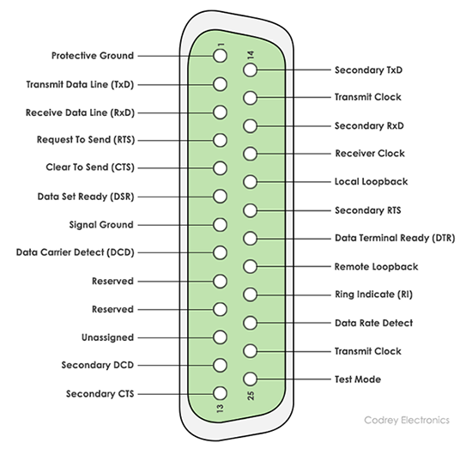
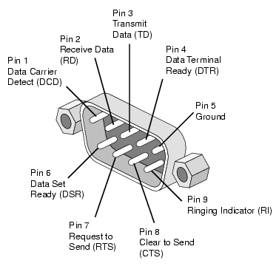
RS232
RS232 is the interface mainly used for serial data communication.
It supports data transfer rate from about 110bps to about 115200 bps (bits per sec).
Hyper terminal is the application mainly used to check serial communication port of the computer, often referred as COM port.
The interface is two types DB9 and DB25 pin connectors. The interface is mainly used for one to one serial communication.

